Slide 1

Face and Emotion detection system
Author: Aarush Agarwal
Notes:
Preworks course home assignments

Slide 2
INDEX
Acknowledgements
About me
My Internship journey with Clevered
My App
Functionality of my App
User Interface
Contact me for questions!

Slide 3
Acknowledgements
It has been an honour designing my project with Ms Shivani and Ms Smita who have been helping me tremendously in every step of the way. Working under the guidance of my mother and Mr Ken has always been a pleasure as well and I am really greatful!

Slide 4
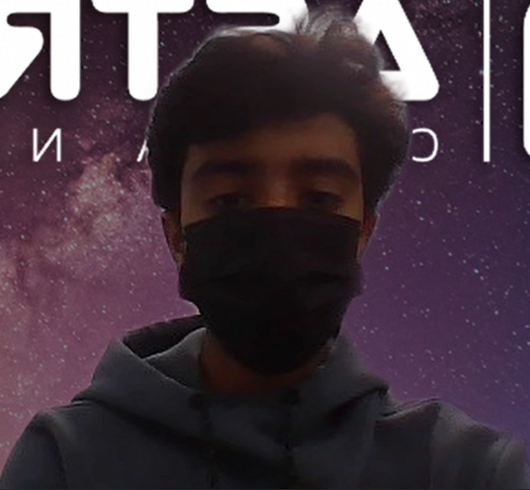
About Me..
My name is Aarush Agarwal and I am a student in 10th grade of The International School Bangalore. AI has always been my passion and I really love to improvise systems that can help the society
My Photograph

Slide 5
My Internship Journey with Clevered
Clevered provides me the perfect platform to not only learn more about python and AI but also, it has given me the opportunity to interact with complex topics of python in great detail. Understanding and writing code using “Deep Learning” has always been in my great interests and Clevered has awarded me with just that.

Slide 6
My App
My App is very simple to use. It has one clickable button on its main menu that can allow the user to use live detection.
My App is a face and emotion detection with a recommendation system whose sole purpose is to detect emotions on people’s faces and then recommend them a video to cheer them up

Slide 7
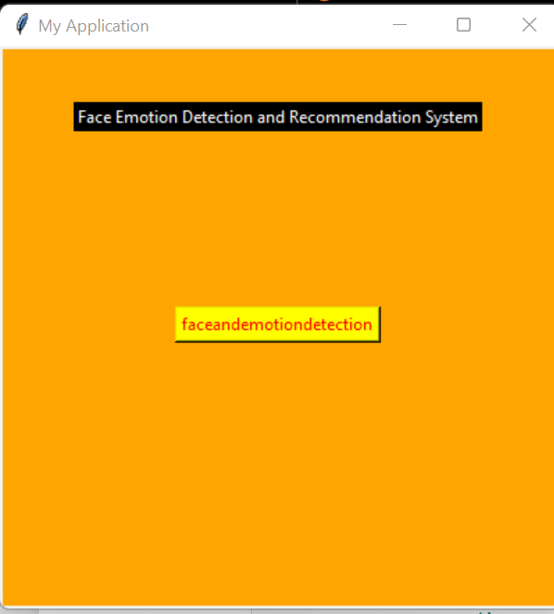
Face and emotion detection and recommendation system
After the program has runned, we just have to click the button to start the detection.
Please have the camera enable so that the haar cascade can detect your face.
Secondly, try to remain as still as possible for maximum efficiency.
Lastly, only one person can have their emotion detected at a time.

Slide 8
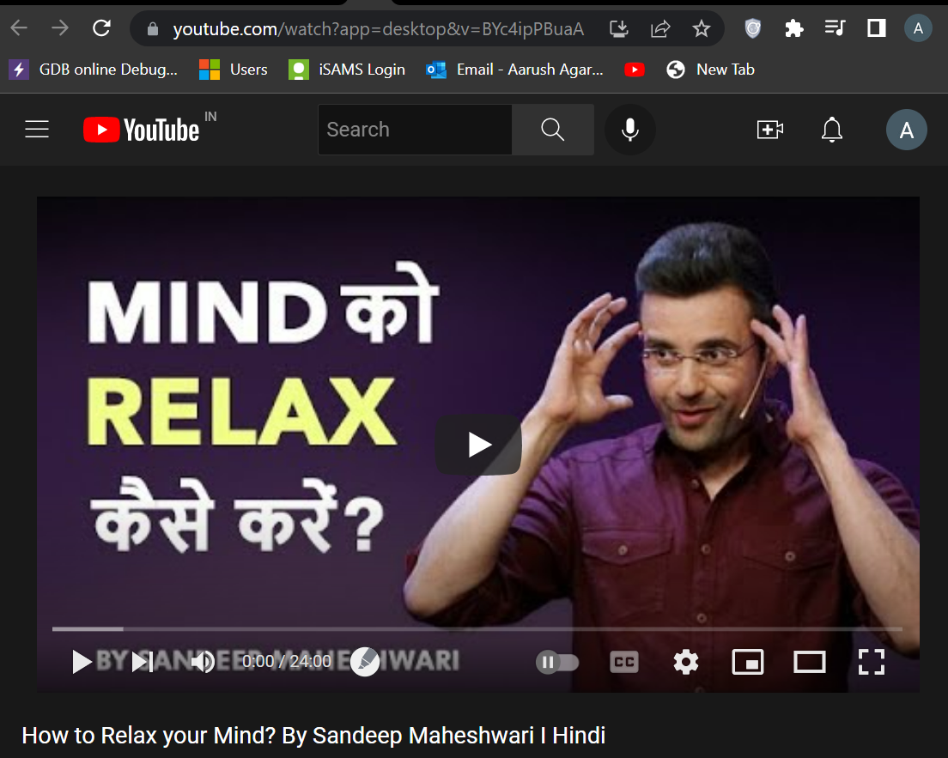
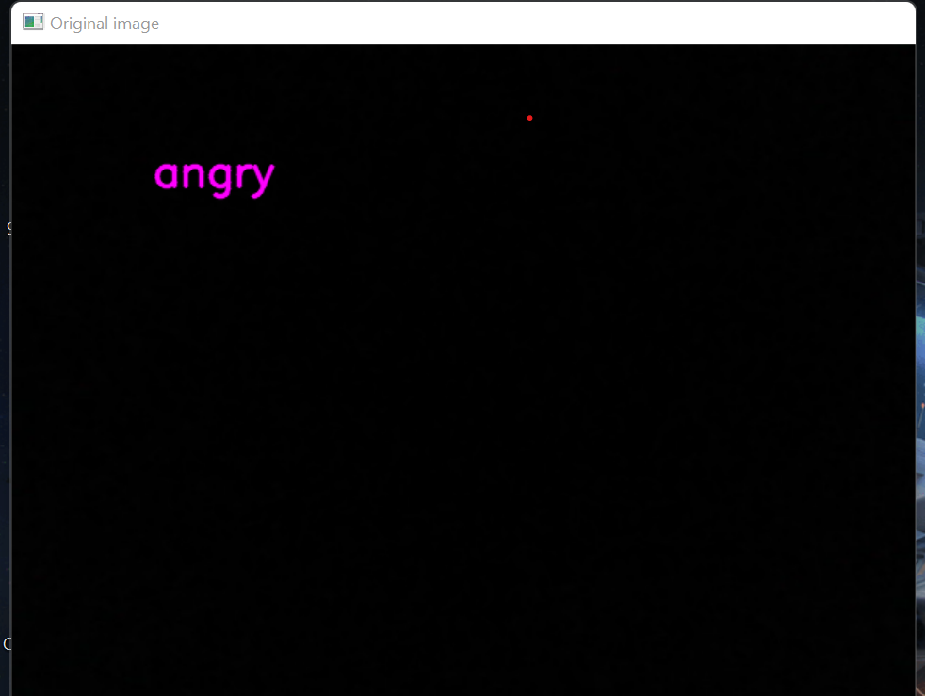
How to use the app
After the face and emotion is clicked by the user. The app opens a new window where the user can get their emotions detected and recommended a video to cheer them up.
For example- if I am angry then this video will appear.

Slide 9


